Slide 1
Genetic variation and common human diseases
Pak Sham
Director, Centre for Genomic Sciences
The University of Hong Kong
27th November 2018

Slide 2
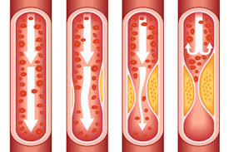

Common diseases
Single-gene diseases are distinct entities – patients are clear “outliers” from the general population
In contrast, common diseases often reflect underlying pathology that is continuous in nature.
The underlying continuous pathology may be determined by multiple genetic and environmental factors

Slide 3
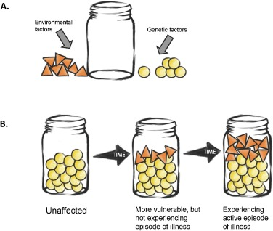
Multifactorial model for disease
Numerous genetic and environmental factors contribute to disease
When total burden of risk factors (liability) reaches a particular level (the threshold), disease occurs
From Hoang, Cytrynbaum & Scherer, 2017

Slide 4
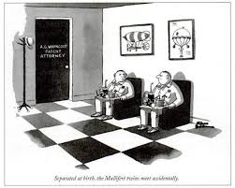
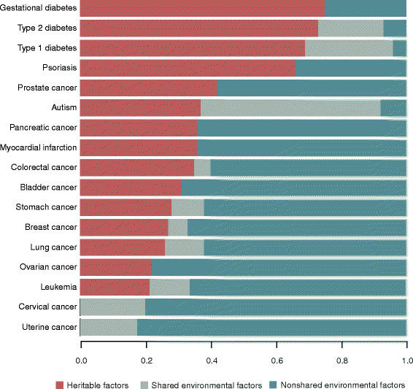
Heritability of common diseases
Total genetic contribution to a disease (heritability) can be estimated from twin or adoption studies
Most common human diseases have moderate to high heritability
Castillo-Fernandez, Spector & Bell, 2014

Slide 5
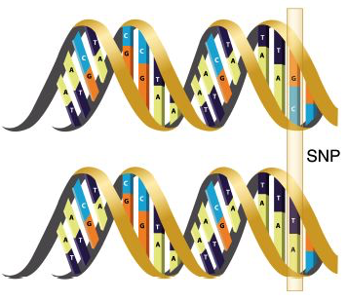
Genetic variations and disease
Genetic factors: individual differences in genome sequence that influence disease risk
Genetic differences (variants / polymorphisms) arose from ancestral mutations.
Some mutations have large impact and cause rare “monogenic” diseases
Variants that contribute to common diseases have milder effects and can be common or rare.
G/T (or C/A) single nucleotide polymorphism (SNP)
http://www.mdsupport.org/images/geneticsexplained2.jpg

Slide 6

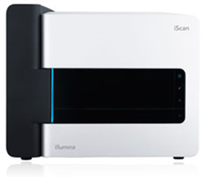
Genotyping / Sequencing Technologies
Almost all common variants in human genome now documented by HapMap and 1K Genomes Projects.
Efficient SNP arrays (e.g. Illumina iScan) cover nearly all common variants.
Many rare variants undocumented despite large databases such as ExAC and gnomAD
Comprehensive rare variants analysis requires high-throughput sequencing technologies (e.g. Illumina NovaSeq)
High-throughput sequencing remains an order of magnitude more expensive than SNP arrays.

Slide 7
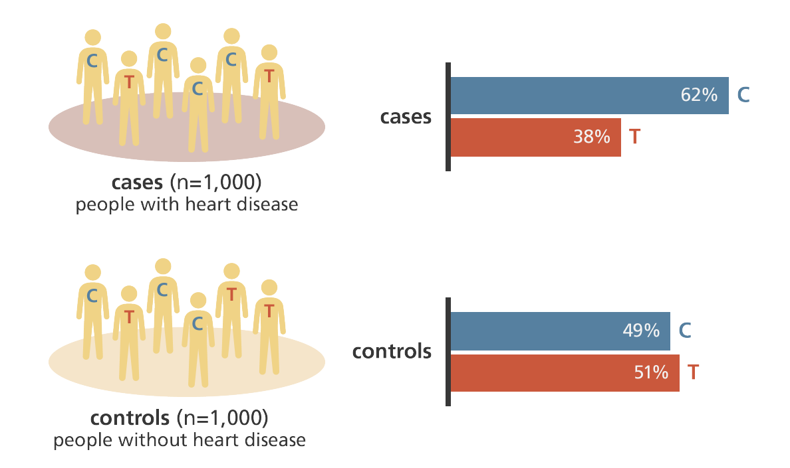
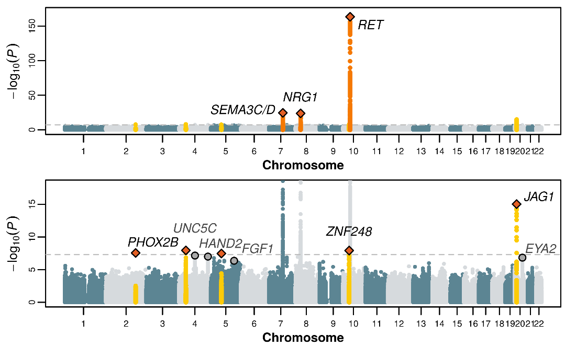
Genome-wide association studies
Variant frequency difference
https://www.yourgenome.org/stories/genome-wide-association-studies
“Manhattan” Plots
Stringent significance threshold to control the number of false positive associations
Large sample size required to achieve adequate statistical power

Slide 8
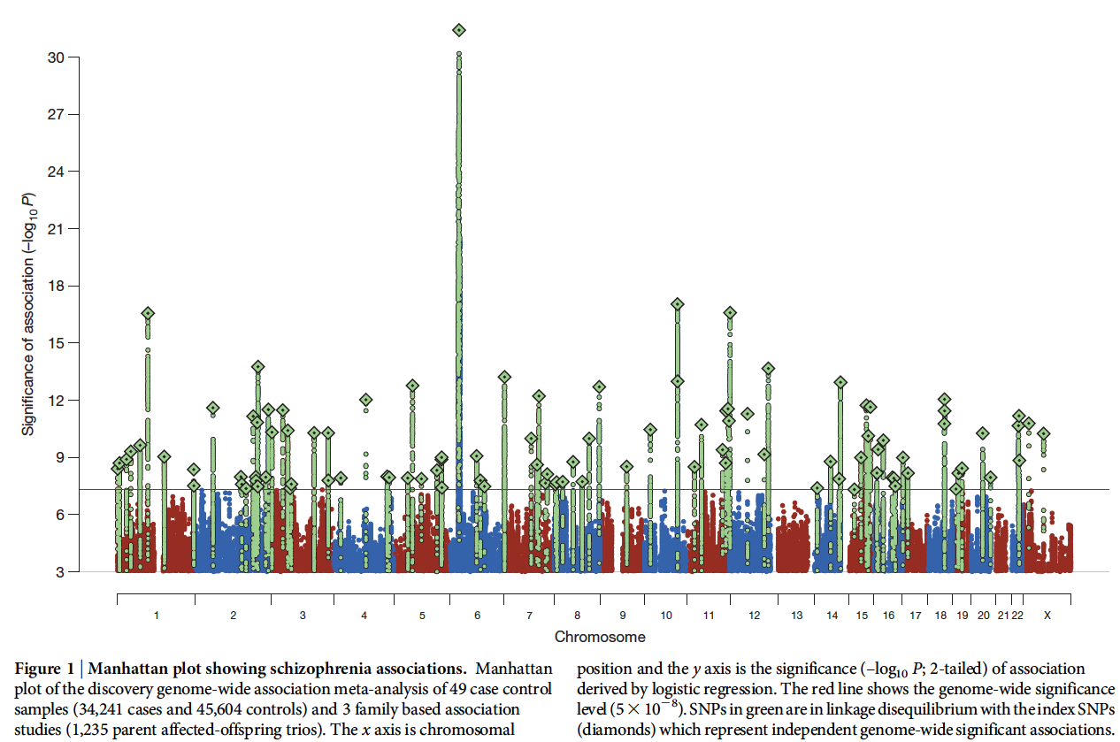
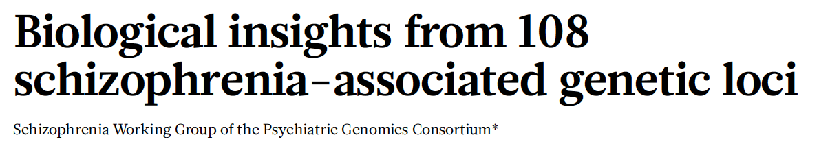
Example: schizophrenia
Nature 511, 421-427 (24 July 2014)

Slide 9
Accumulation of GWAS findings
>10,000 genome-wide significant associations with common diseases / traits
Visscher et al, 2017

Slide 10
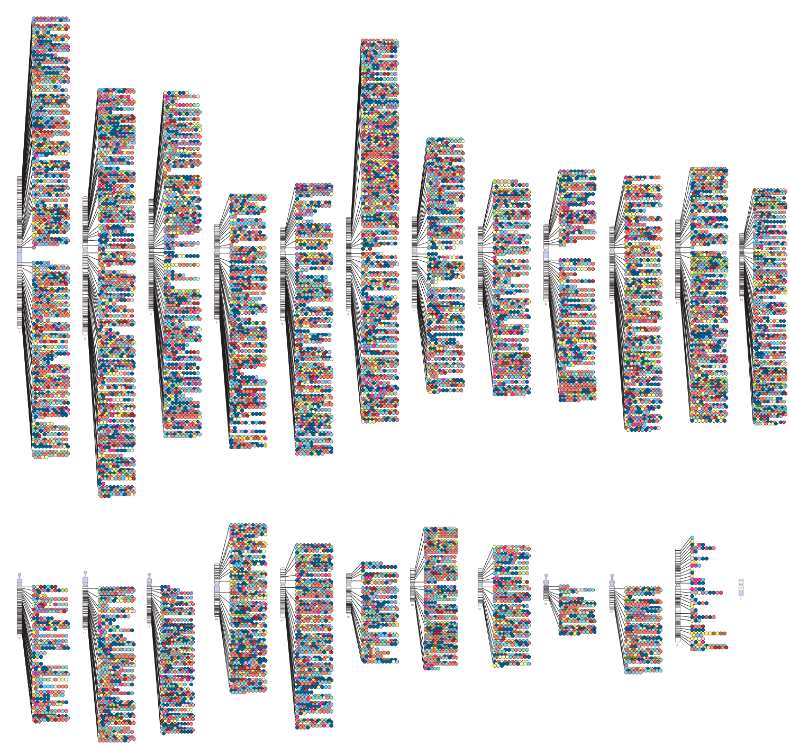
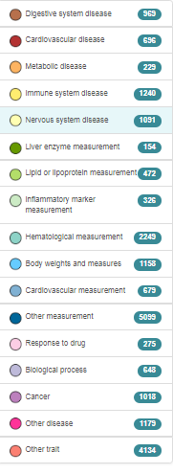
Current status of GWAS
2018 Quarter 1
Figure source: https://www.ebi.ac.uk/gwas/
>78,000 robust associations with >300 complex diseases and traits

Slide 11
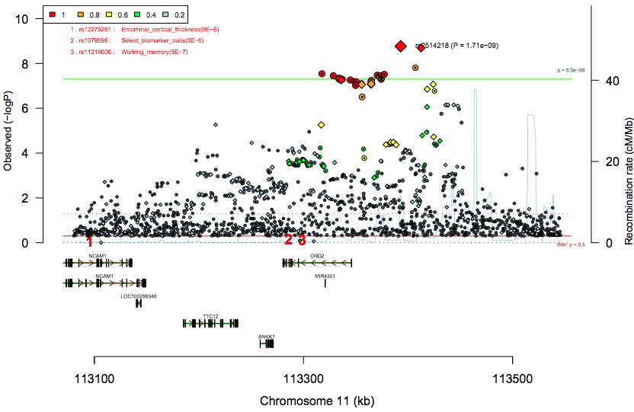
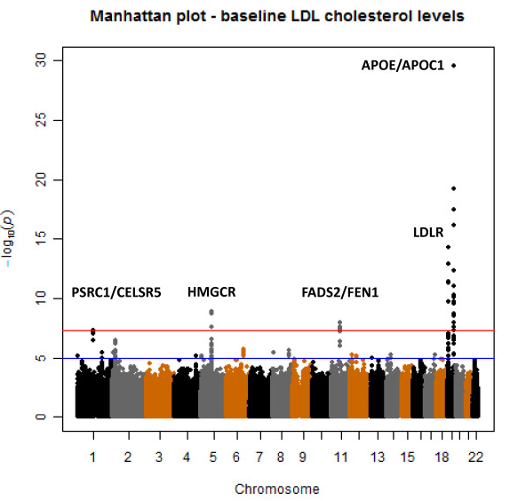
Predicting drug targets
Dopamine D2 receptor gene (DRD2) associated with schizophrenia
Dopamine D2 blockade is the mechanism of current antipsychotic drugs
LDL-associated genetic variant near HMGCR decreases LDL-C levels by 2.5 mg/dL
Statins inhibit enzyme encoded by HMGCR and typically decreases LDL-C levels by 14-70 mg/dL
Trompet et al, 2011

Slide 12
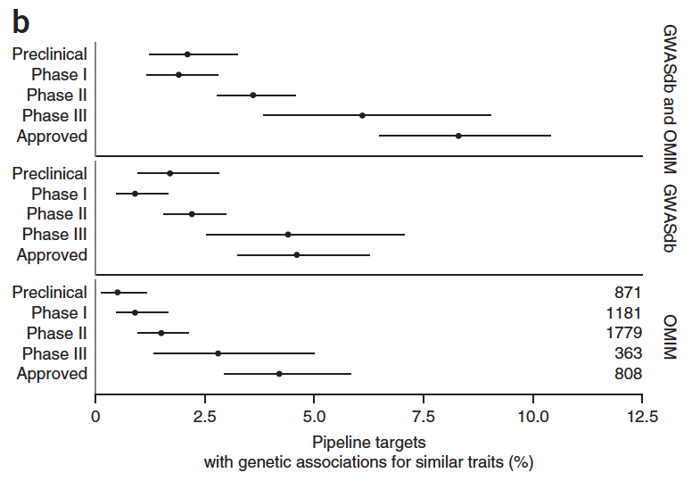
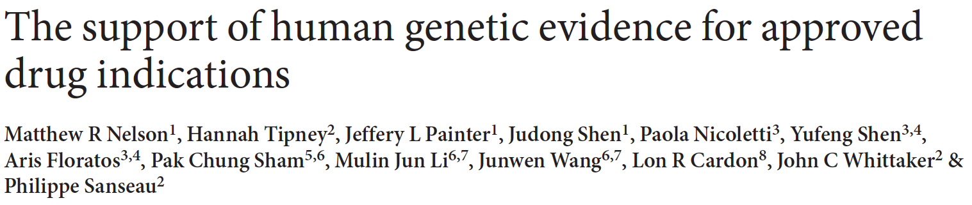

Predicting successful drug targets
The proportion of drug targets with direct genetic support increases from 2.0% at the preclinical stage to 8.2% among targets for approved drugs

Slide 13
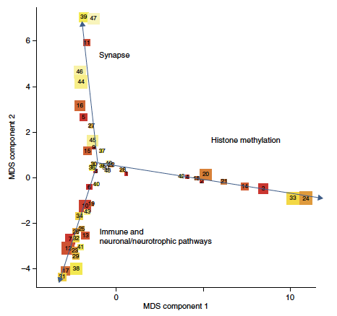
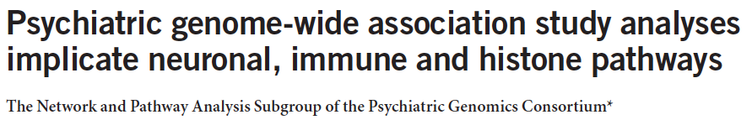
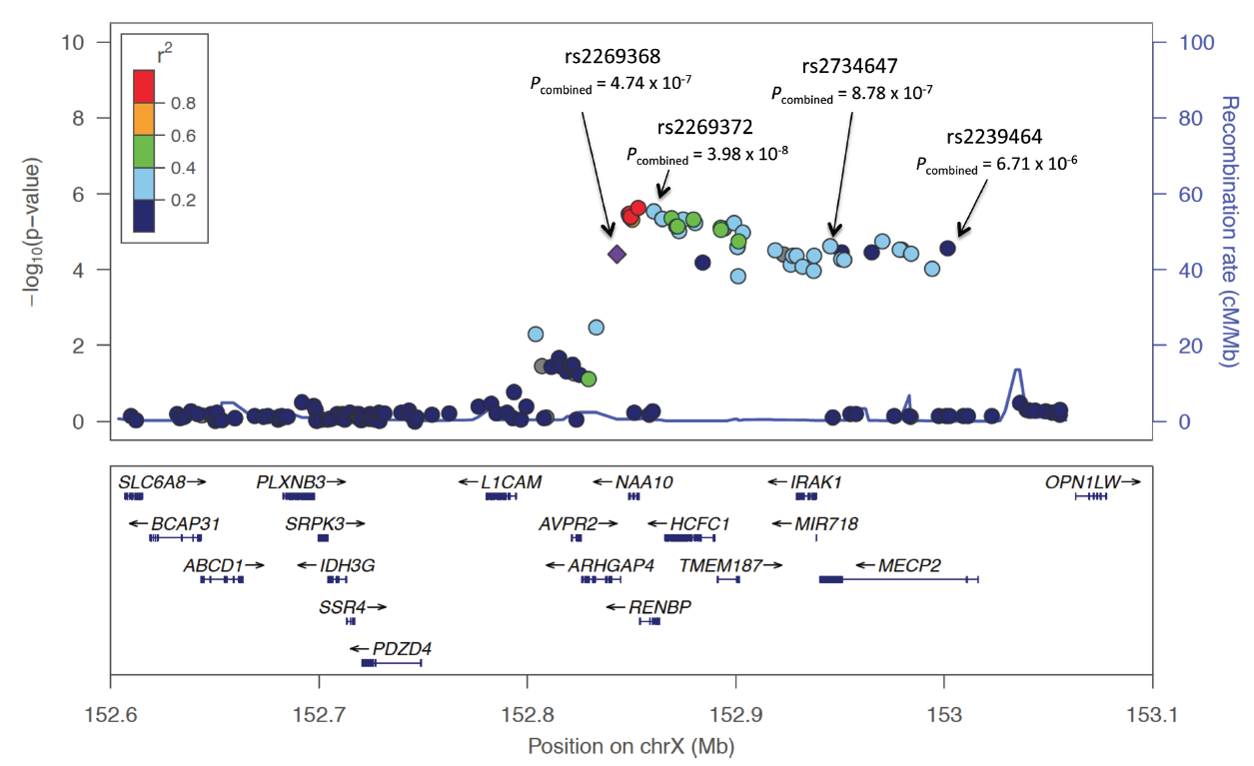
Implicating biological pathways

Slide 14
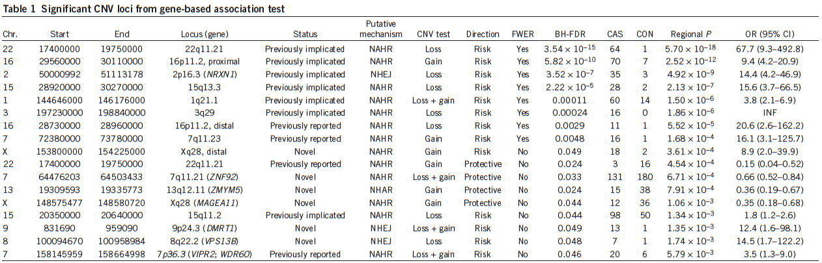
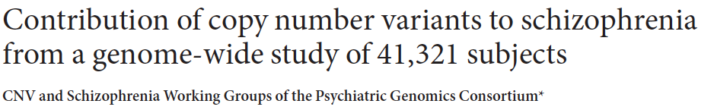
Converging rare & common variants
Presynaptic adhesion molecules NRXN1, NRXN2
Postsynaptic scaffolding proteins DLG1, DLG2, DLGAP1, SHANK1, SHANK2
Glutamatergic ionotropic receptors GRID1, GRID2, GRIN1m, GRIA4
Dystrophin and its synaptic interacting partners DMD, DTNB, SNTB1, UTRN

Slide 15
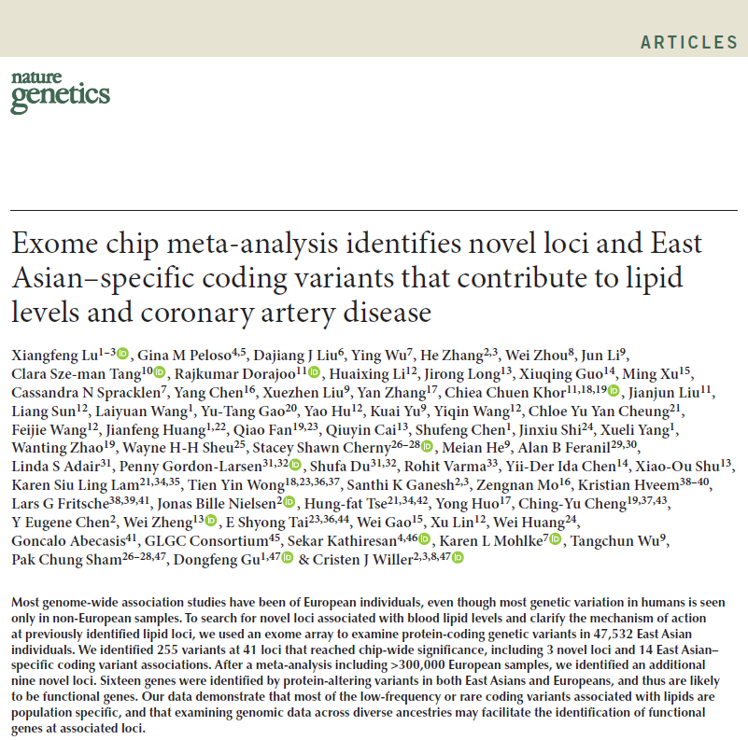
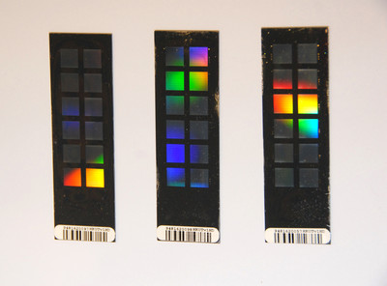
Associations specific to population
Genetic variants vary in frequency and effect in different populations
Analysis of 47,532 East Asians using Exome Chip revealed 14 significant associations not present in other populations.
Of these, 12 had much lower variant frequency (<1%) in Europeans, and the other 2 had smaller effect size (1 being in the opposite direction)

Slide 16
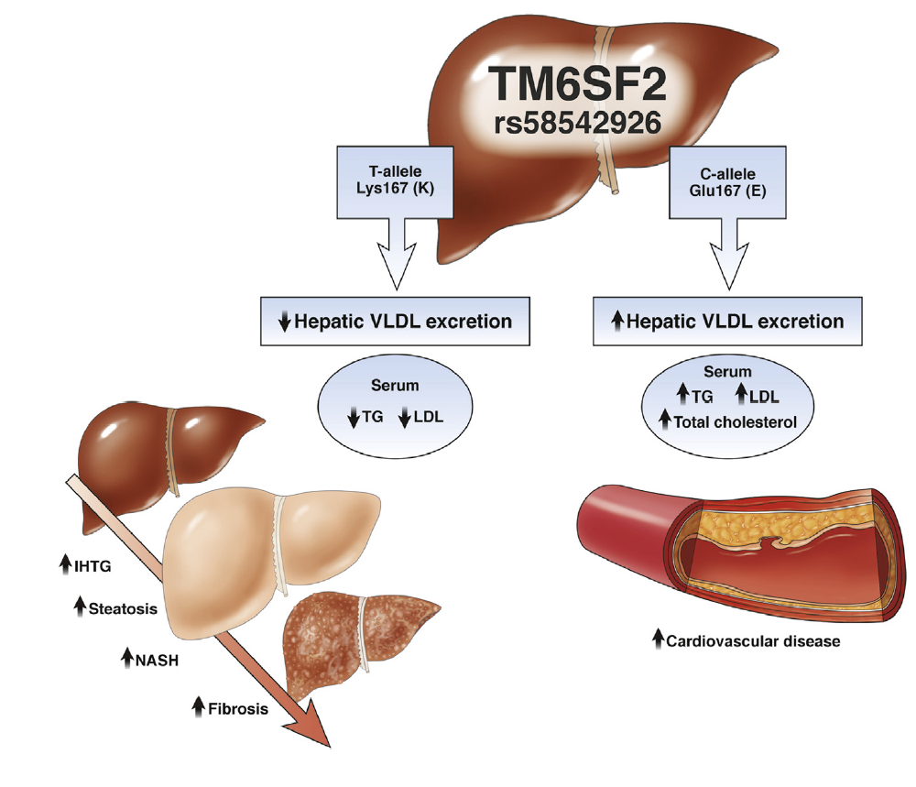
Variants affected multiple traits
TM6SF2 involved in VLDL efflux from liver to blood
Increased activity raises blood VLDL level and increases coronary heart disease risk
Decreased activity leads to increased lipid accumulation in liver and non-alcholic fatty liver disease
A “Catch-22” situation
Kahalli et al, Gastroenterology 2015

Slide 17
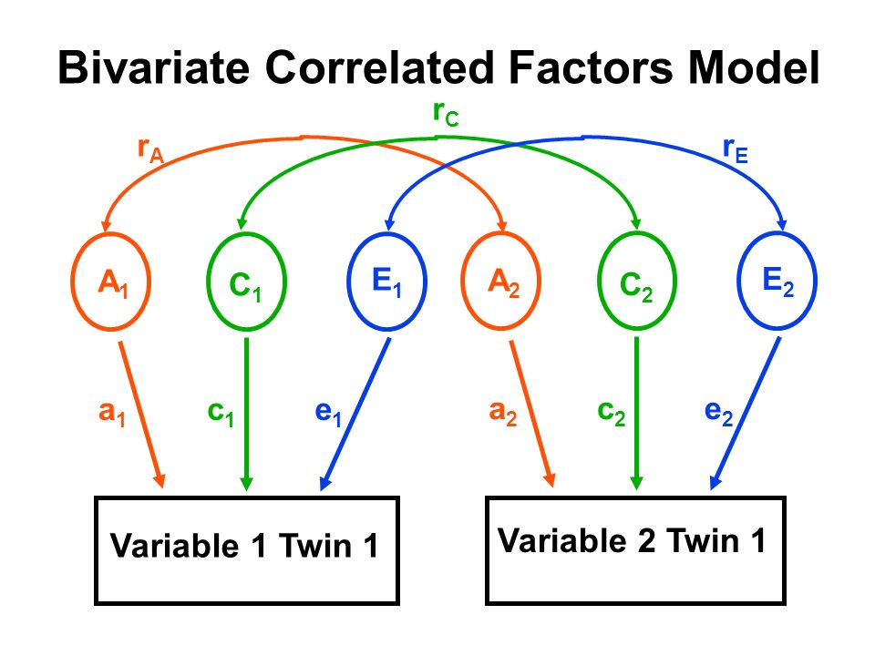
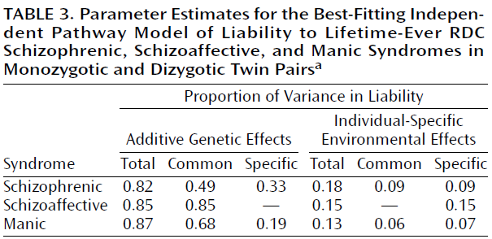
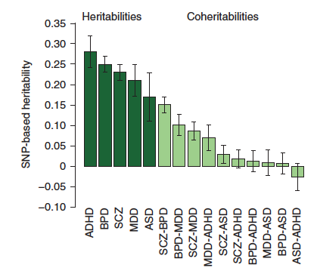
Diseases affected by same genes
Cardno, Rijsdijk, et al, Am J Psychiat, 2002
Twin studies indicated substantial genetic sharing between schizophrenia and bipolar affective disorder
This has been confirmed by GWAS
Cross Disorder Group of the PGC, Nature Genetics 2013

Slide 18
Map of genetically related diseases
Genetic sharing is greatest for diseases affecting the same cell type / organ / system, e.g. metabolic disorders, psychiatric disorders
Bulik-Sullivan et al, Nature Genetics, 2015

Slide 19
Resolving causal relationships
Causal inference complicated by confounding
Mendelian randomization: instrumental variable related to outcome only through exposure
Genetic variants provide multiple valid instruments
Consistent estimates implicating causal relationship of non-HDL cholesterol on coronary heart disease
C
b
I
X
Y
Common
Rare
Helgadottir et al. 2016
Tang et al. (2015)

Slide 20
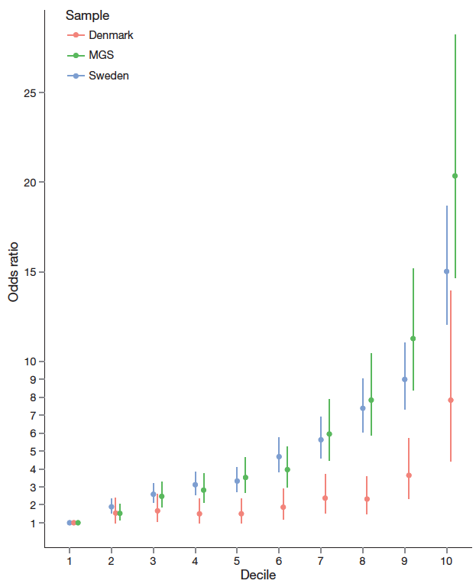
Predicting disease risk
For a polygenic disease, every person carries a certain number of high-risk genetic variants
Cumulative effect of all high-risk variants present in a person: “polygenic risk score”
Population can be stratified by polygenic risk score, e.g. into deciles, in ascending disease risk
For schizophrenia, the highest and lowest deciles have 8-20 fold risk difference (similar effect as a positive family history)

Slide 21
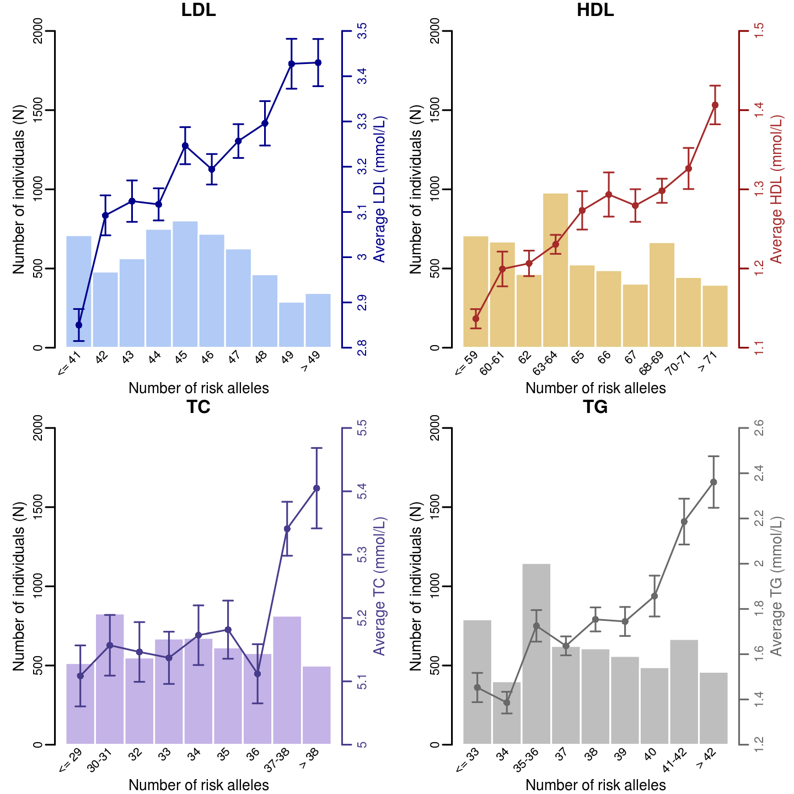
Polygenic scores for risk factors
The effects of some genetic variants on disease risk may be mediated through known risk factors
Blood lipid levels are risk factors for coronary heart disease (CAD)
“Polygenic scores” for blood lipid levels predict CAD risk

Slide 22
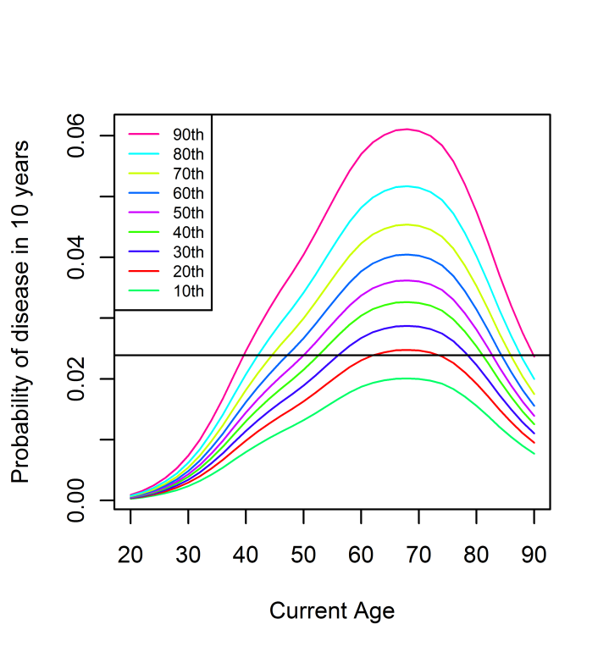
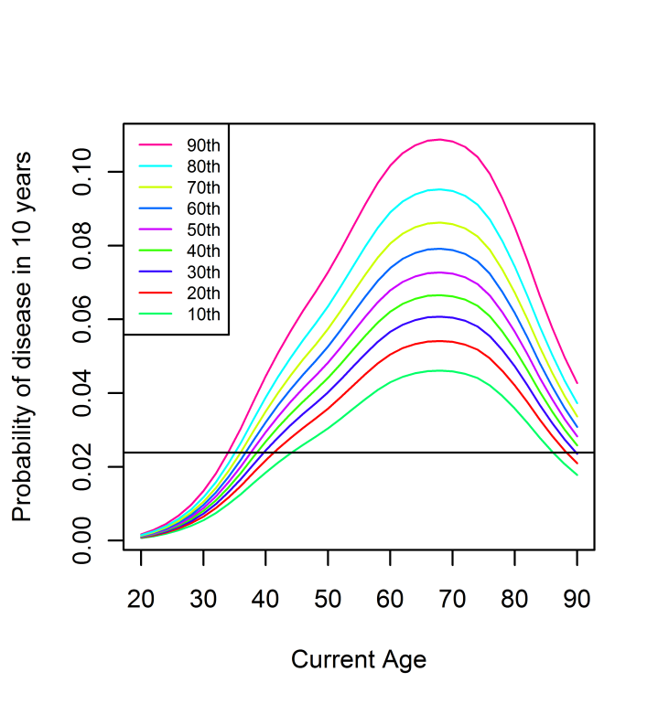
Application to cancer screening
FH+
General population
Having affected first degree relative
Breast cancer screening may commence earlier in women with high polygenic scores and / or positive family history
So et al, American Journal of Human Genetics 2012

Slide 23
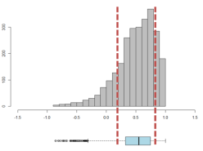
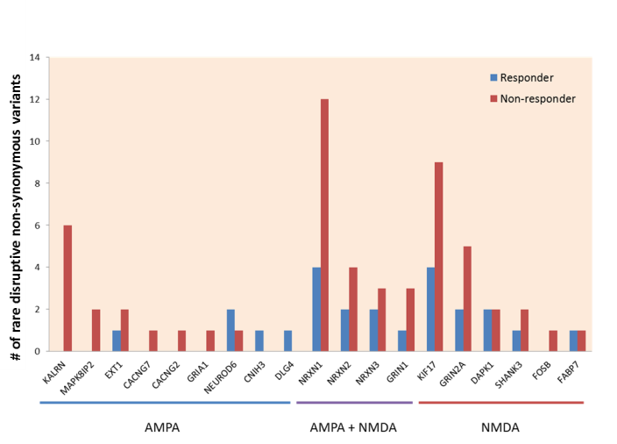
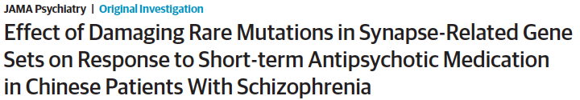
Predicting treatment response
Two gene-sets with excess rare damaging variants in schizophrenia patients not responsive to antipsychotic medications
Reduced NMDA-mediated synaptic currents
Reduced AMPA-mediated synaptic currents

Slide 24
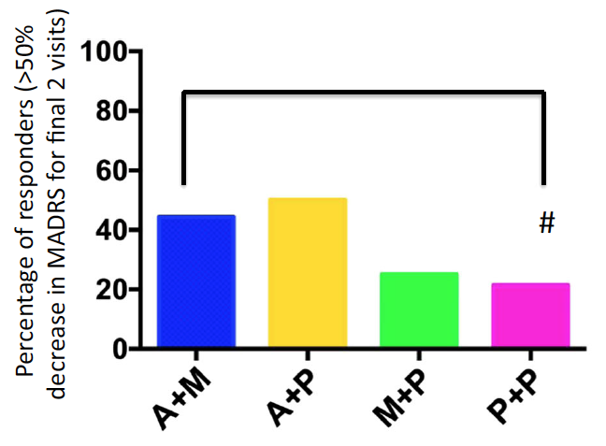
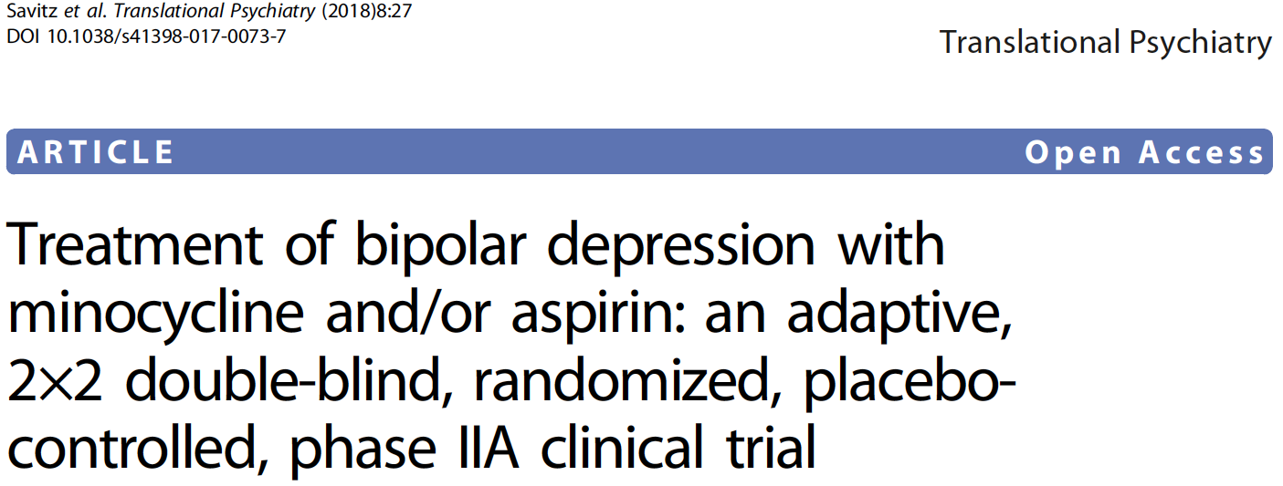
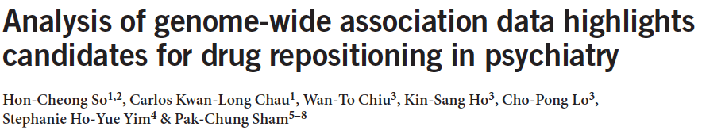
Repositioning current drugs
Using tissue-specific e-QTL data (e.g. GTEx), GWAS results can predict disease-associated gene expression changes
Many existing drugs have documented effects on gene expression.
A drug that reverses disease-related gene expression changes may be effective in treating the disease
Example: aspirin was identified as a possible treatment of bipolar disorder.
Nature Neuroscience, 2017

Slide 25
Future Trends
Large population cohorts with comprehensive assessments of multiple clinical outcomes, intermediate phenotypes, biomarkers, lifestyle and environmental factors (e.g. UK Biobank)
Large-scale whole-genome sequencing (e.g. UK 100,000K Project), enabling comprehensive assessment of rare variants
Linking up genetic data with clinical databases and other data domains
Greater integration of genetic data with functional annotation (e.g. eQTL, Roadmap Epigenome, ENCODE)
Greater use of functional assays for evaluating the consequences of genetic mutations

Slide 26

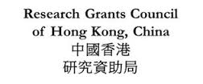

Acknowledgments
Innovation and Technology Commission
Suen Chi-Sun
Foundation
Centre for Genomic Sciences
The University of Hong Kong

